Slide 1
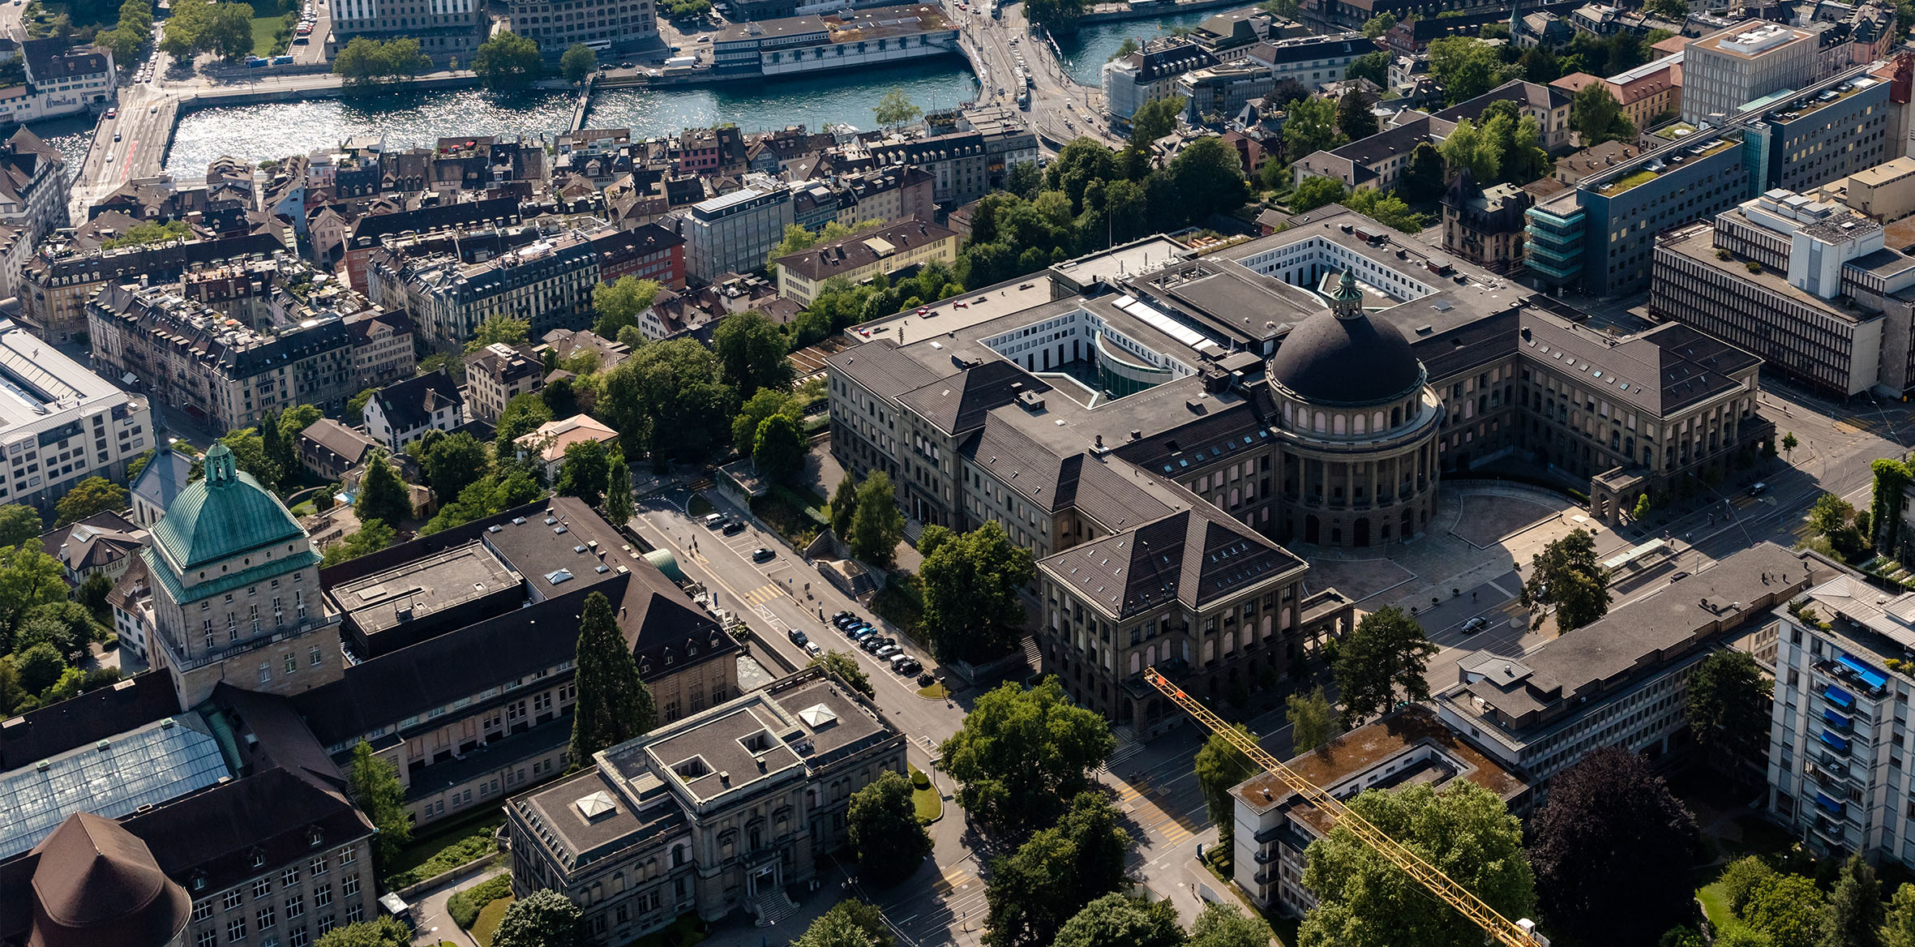

Carbon Dioxide to 1-Propanol Weekly Update
Institute for Chemical and Bioengineering
Sustainable Process Systems Engineering Lab
Abhinandan Nabera
20. July 2022

Slide 2
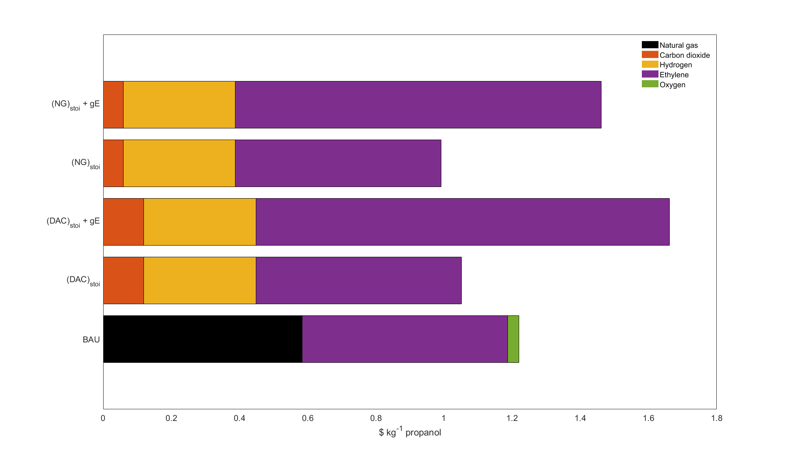
Meeting Minutes (06.07.2022)
Stoichiometric results, working on simulating the BAU process

Slide 3
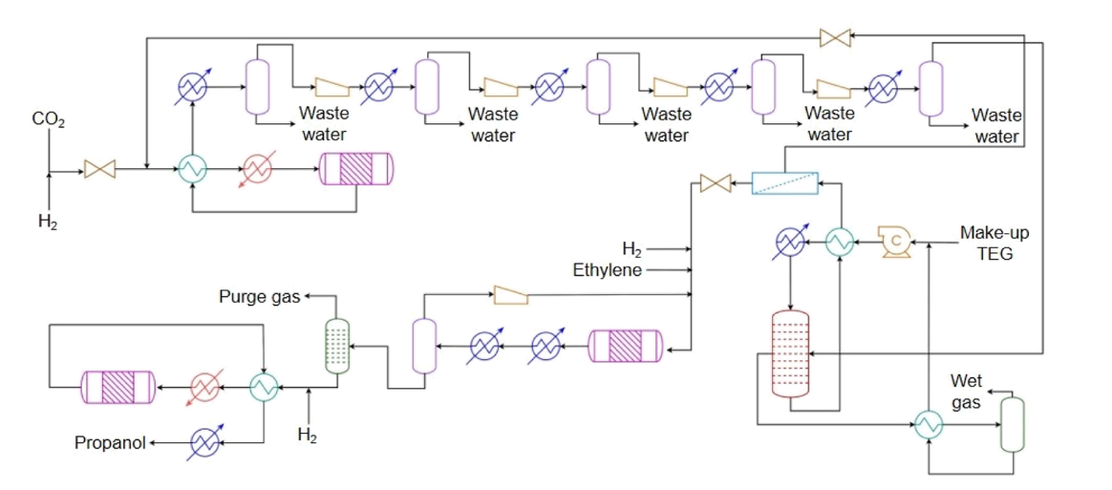

BAU vs Proposed Route
Main reactions
RWGS: ${CO}_{2}+ H_{2}→ CO+ H_{2}O$
Hydroformylation: $C_{2}H_{4}+CO+ H_{2}→ {CH}_{3}{CH}_{2}CHO$
Hydrogenation: ${CH}_{3}{CH}_{2}CHO+ H_{2}→ {CH}_{3}{CH}_{2}{CH}_{2}OH$
Side reactions
Hydroformylation: $C_{2}H_{4}+H_{2}→ C_{2}H_{6}$
Essentially the same
Only difference is
BAU: syngas from steam reforming
Proposed route: syngas from carbon dioxide
Proposed Method
RWGS
Hydrogenation
Hydroformylation
BAU
Syngas from SMR

Slide 4

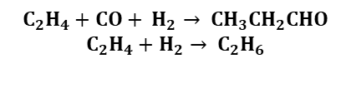
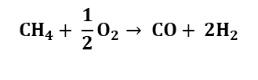
Elementary Flowsheet – BAU Process
POX
TEG dehydration
(<0.1 ppm)
Hydroformylation
Carbon capture
Hydrogenation
Natural gas
Oxygen
Ethylene
Make up hydrogen
$$CH_{4}+ \frac{1}{2}O_{2}→ CO+ {2H}_{2}$$
$${CH}_{3}{CH}_{2}CHO+ H_{2}→ {CH}_{3}{CH}_{2}{CH}_{2}OH$$
$$C_{2}H_{4}+CO+ H_{2}→ {CH}_{3}{CH}_{2}CHO$$
$$C_{2}H_{4}+H_{2}→ C_{2}H_{6}$$

Slide 5
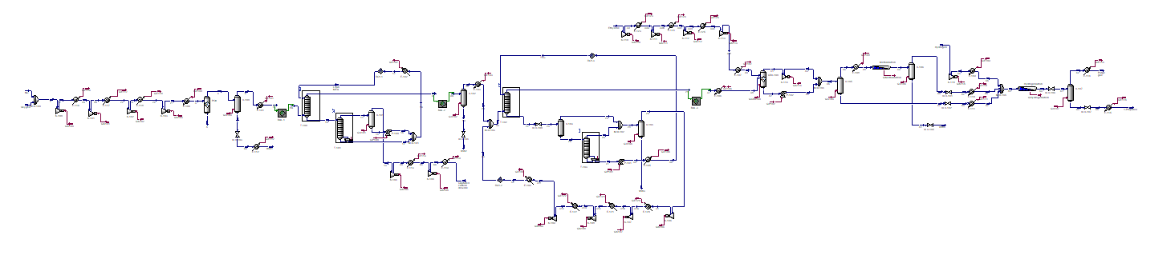
Aspen Screenshot

Slide 6
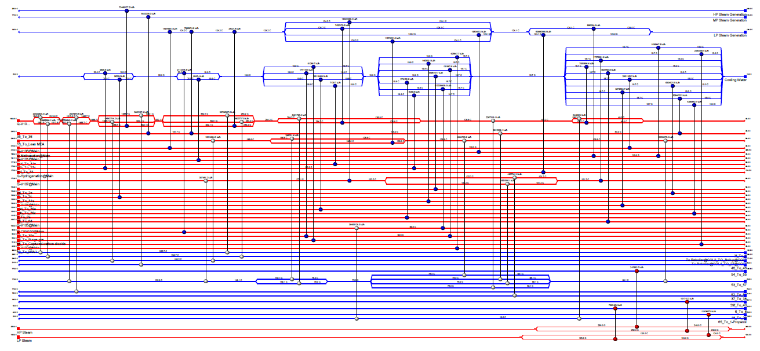
Heat Integration Screenshot

Slide 7
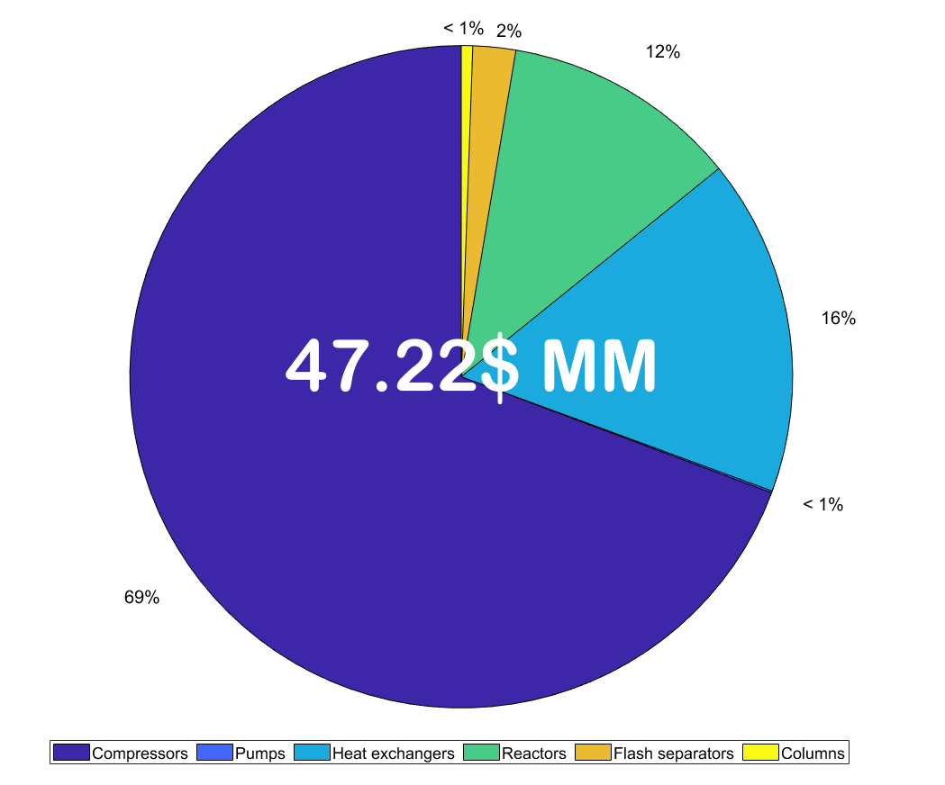
Results - CAPEX

Slide 8
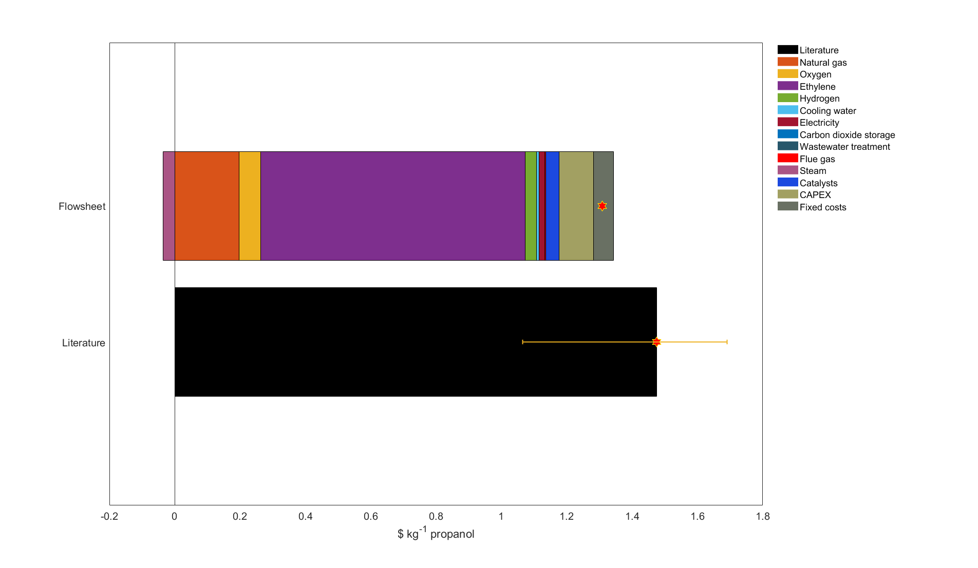
Results - Economics

Slide 9
Economics Summary
Purchased equipment cost 2022 (M$/year) | 47.31
Installed capital cost | 176.94
Offsites (OS) | 53.08
Design and engineering (D&E) | 69.01
Contingency (X) | 23.00
Fixed capital investment | 322.02
Working capital | 48.30
Total investment | 370.33
Labor costs | 7.34
Maintanance costs | 5.31
Overhead expenses | 12.82
Interest | 2.90
Project lifetime | 25.00
Interest rate | 0.12
ACCR | 0.1275
CAPEX (M$/year) | 47.22
Fixed production costs (M$/year) | 28.37
OPEX (M$/year) | 518.22
Total expenses (M$/year) | 593.81
Total expenses ($/hr) | 74226.16
Total propanol produced (kg/hr) | 56724.82
Cost of propanol per kg | 1.3085
Cost of propanol per ton | 1308.53
CAPEX short summary
Unit operation | CAPEX [M$/year]
Compressors | 32.72
Pumps | 0.04
Heat exchangers | 7.76
Reactors | 5.44
Flash separators | 0.99
Columns | 0.26
Total | 47.22
OPEX short summary
Category | M$/year
Natural gas | 89.62
Oxygen | 29.43
Ethylene | 367.65
Hydrogen | 16.06
Cooling water | 3.54
Electricity | 7.44
CO₂ capture and storage | 0.31
Wastewater treatment | 0.11
Flue gas emissions | 1.56
Steam | -16.02
Catalyst | 18.53
Total | 518.22
Production costs short summary
Category | M$/year
Labor | 7.34
Maintanance | 5.31
Overhead | 12.82
Interest | 2.90
Total | 28.37

Slide 10
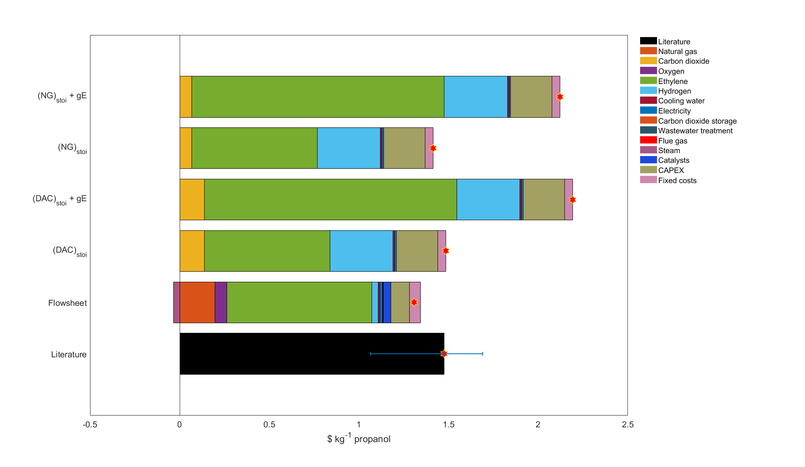
Results - Economics

Slide 11
Path Forward
Complete and optimize the flowsheet for the green process
Calculate the economics of the green process
Find break even prices of raw materials (e.g. carbon dioxide, hydrogen, ethylene, green-ethylene etc.)

